Slide 1
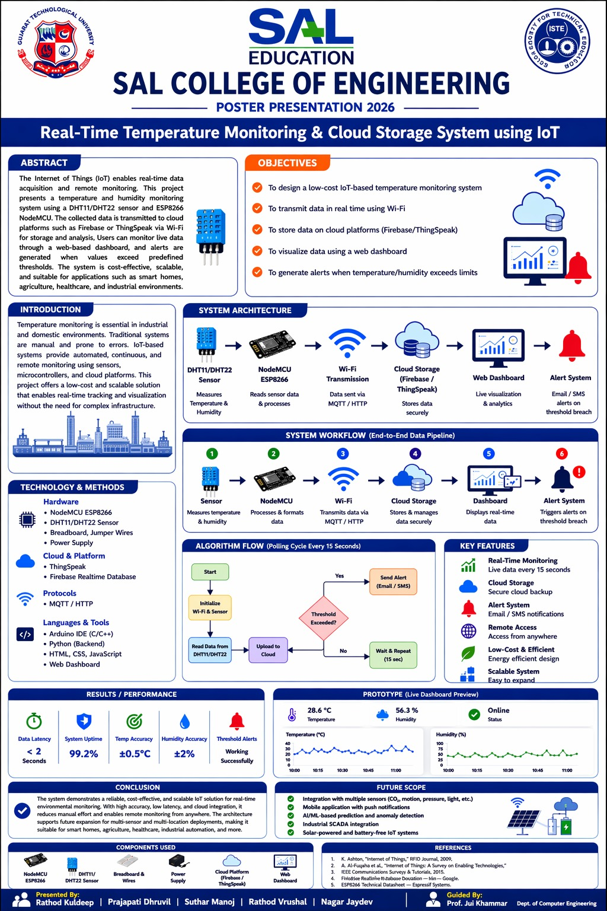



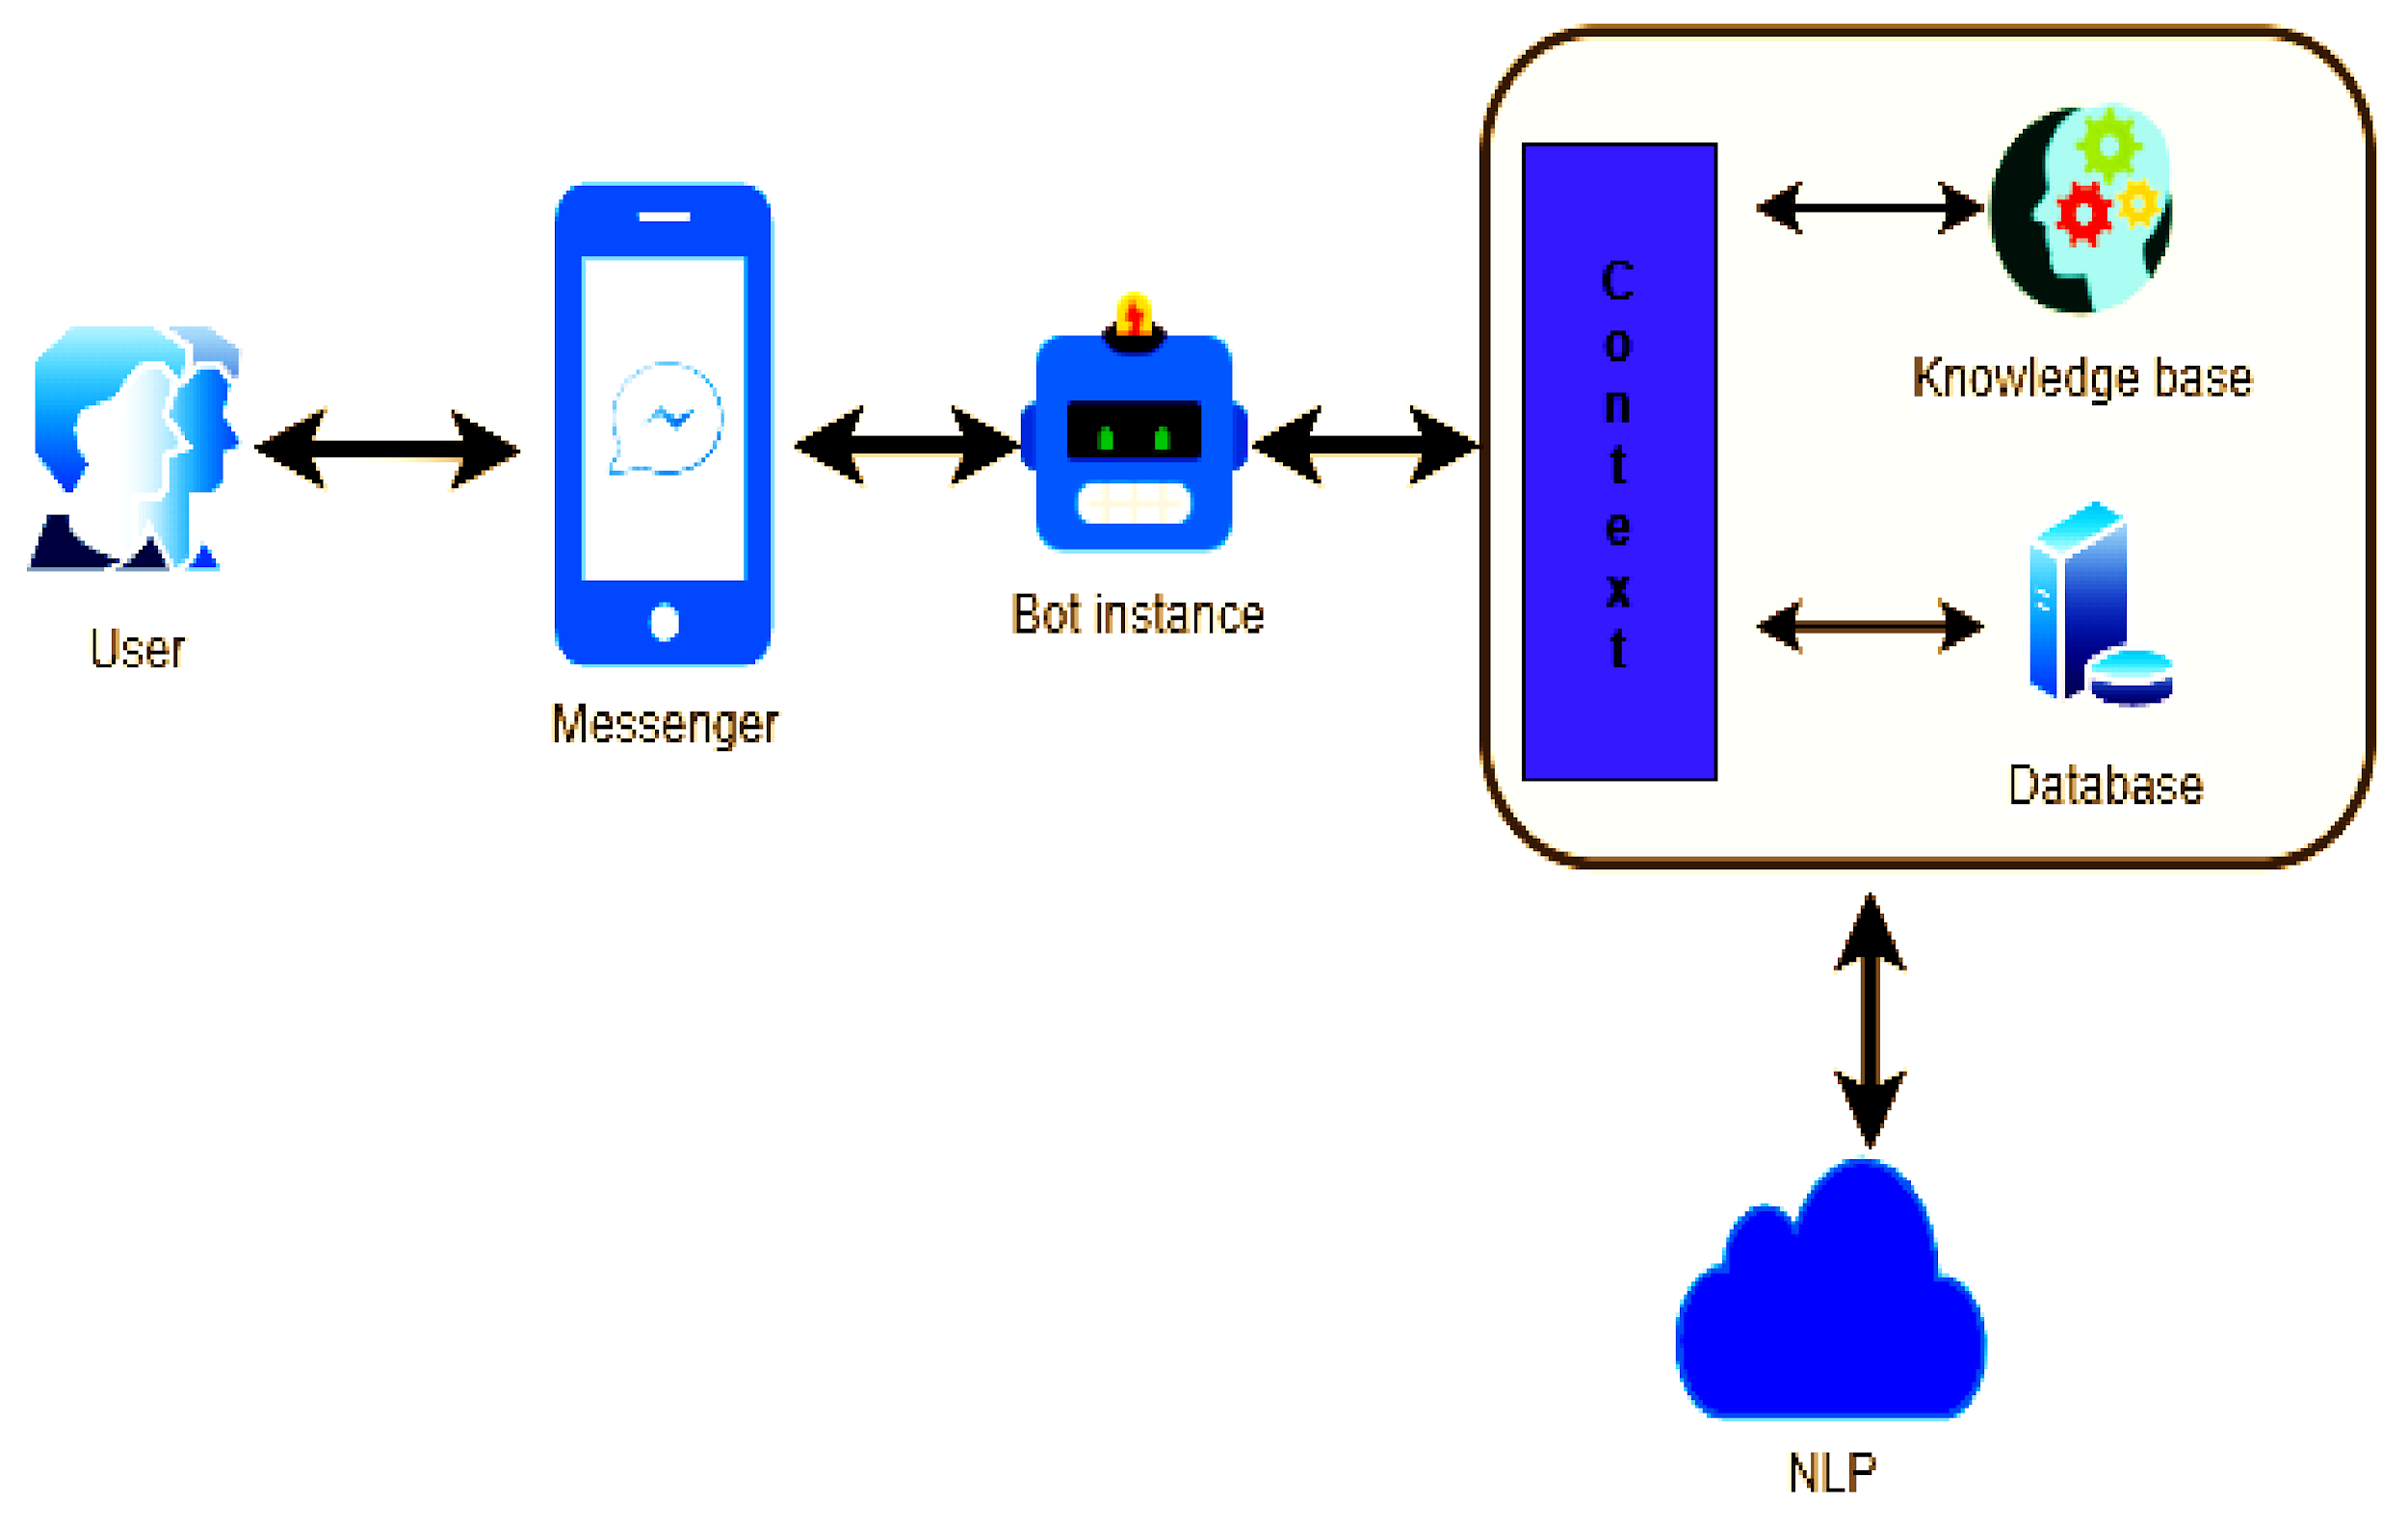
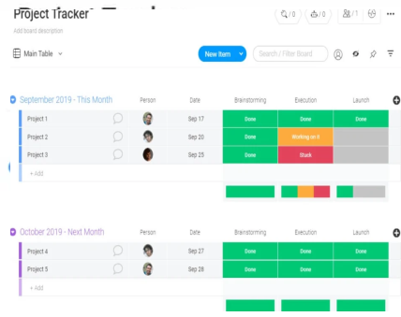

SAL COLLEGE OF ENGINEERING
POSTER PRESENTATION 2026
Real Time Temperature Monitoring and cloud storage system using IoT
Abstract
ABSTRACT
Objectives
The Internet of Things (IoT) enables real-time data acquisition and remote monitoring. This project presents a temperature and humidity monitoring system using a DHT11/DHT22 sensor and ESP8266 NodeMCU. The collected data is transmitted to cloud platforms such as Firebase or ThingSpeak via Wi-Fi for storage and analysis. Users can monitor live data through a web-based dashboard, and alerts are generated when values exceed predefined thresholds. The system is cost-effective, scalable, and suitable for applications such as smart homes, agriculture, healthcare, and industrial environments.
we construct a Chabot based on a neural network to aid in the resolution of the user's query. The proposed system aims to create an appropriate neural network algorithm that can be used to forecast demand for outgoing distributed products, and then to evaluate the performance of the chosen algorithms by conducting an experiment to investigate the possibility of using long-term proposed system. using long-term we construct a Chabot based on a neural network to aid in the resolution of the user's query. ng long-term proposed system. using long-term (Text Font = Times New Roman – Size 24, Maximum word = 90)
Workflow / Process / Flow Chart
Introduction
E-commerce has become a part of our everyday lives because technological advancements have allowed people to sit in the comfort of their homes and shop online without having to go to a physical store. This project is divided into two major categories: administrators and customers. As administrators, store managers and employees can add, edit, update, or remove products. They can also change product names, prices, and add or remove products. The customer can search for products, add items to their cart, remove items from their cart, and pay at the store. They can also update their information such as names, addresses, and other details. Understanding the wider context of e-business is essential because it has a growing impact on our world and has revolutionized many aspects of human activity. The literature review attempts to explore this impact and come to useful conclusions about where the project should focus in order to be successful. The success and failure factors of e-business are also explored, as are some cases of companies that have successfully implemented e-business into their operations. (Text Font Times New Roman –Size 24, Maximum word = 180)
Technology / Methods/ Algorithm
Prototype
Algorithm : LSTM – Deep Algorithm, NLP
Languages. Which languages do you want your chatbot to “speak”? English, French, German, Arabian, etc? Should it speak one language or multiple?
Integrations. Which tools do you need the chatbot to be integrated with? CRM, payment system, calendars, maps, custom internal tool, etc.KPIs and metrics. Be sure to specify if you have that you want the chatbot to meet.
Technologies. Do you have any specific technologies you want the chatbot to be built with?
NLP and AI. Do you want the chatbot to have decision tree logic, Machine Learning (ML), Natural Language Processing (NLP), or Artificial intelligence (AI)? (Text Font Times New Roman –Size 24, Maximum word = 100)
MOBILE TRACKER WEBSITE PAGE
Results / Outcome
ALGORITHM
OBJECTIVES
dataset. The platform can be made available to word press based system because 60% ecommerce websites The reason for building such modular system is to make the system available to more platforms. This present NLU engine trains its classifier from the classified training data provided by the admins. Also, it is based on SVM. Artificial Neural Network can be used to improve the accuracy of the NLU Engine. Also, a semi supervised learning system can be implemented in order to increase the )? Neural Network can be used to improve the accuracy of the NLU Engine. Also, a semi supervised learning system can be implemented in order to (Text Font Times New Roman –Size 24, Maximum word = 120)
Conclusion
MOBILE LOGO
Chatbots are one of the most widely-used and accessible innovations in e-commerce. Although the changes they promote in modernizing customer interactions may seem incremental, the impact of the technology is huge, in the long run.It is clear that chatbots will not be optional in a few years since customers will come companies they are interacting with. promote in modernizing customer interactions may seem incremental, the impact of the technology is huge, in the long run.It is clear that chatbots will not (Text Font Times New Roman –Size 24, Maximum word = 100)
CONCLUSION
References
Future Scope
1.https://www.scribbr.com/citing-sources/citation-example/
2. https://doi.org/10.5590/JOSC.2019.11.1.07
3. https://doi.org/10.5590/JOSC.2019.11.1.076
4. https://doi.org/10.5590/JOSC.2019.11.1.078
5. https://www.scribbr.com/apa-style/format/
(Text Font Times New Roman –Size 24,)
Chatbots also offer the opportunity for customer behavioral prediction, which can help predict customers’ intent to either provide them with more options such as purchasing or providing information on their order, or better gather information for an agent to answer their questions. provide them with more options such as purchasing or providing information on their order, or better gather information for an agent to answer (Text Font Times New Roman –Size 14, Maximum word = 70)
Presented By:- ABC (241133107029),XYZ (241133107030),
Guided By:- Prof. Jui Khamar
Notes:
SAL ENGINEERING & TECHNICAL INSTITUTE – Times New Roman 60.4
POSTER PRESENTATION 2024 BoldArial 52.8
Chat Bot for Ecommerce Title Bold Arial MT 60
Abstract Arial Black 45.3
Presented By:- ABC (21126031001),XYZ (21126031015) font - times new roman - 36
Guided By:- Prof. Ravi Patel font - times new roman - 36

